Slide 1
Embodied Interaction
Abu Saleh MD NOMAN
Keith peden
Wen ng

Slide 2
What is Embodied Interaction?
Embodied interaction is the creation, manipulation and sharing of meaning through engaged interaction with artifacts.
Embodied interaction is when people interact mentally and physically with technology.
It is a position in cogitative science and the philosophy of the mind emphasizing the role that the human body plays in shaping the mind.
This can be used in science, robotics, music and gaming.

Slide 3
What is Embodied Interaction (contd.)?
Embodied interaction is the “intersection of tangible interfaces and social computing” (Lowgren, 2007)
These two areas of research -- tangible and social computing -- have been conducted largely as independent research programs. However, they have a common foundation, and that foundation is the notion of "embodiment“: the way that physical and social phenomena unfold in real time and real space as a part of the world in which we are situated, right alongside and around us.

Slide 4
Two Recent Trends
Social Computing
“activity of the user sitting at a computer is not defined simply by the patterns of their immediate interactions, but by webs of surrounding relationships, practices and activities in which they are each embedded” (Dourish, 1999).
using social understandings of interaction
enhancing interaction with computation

Slide 5
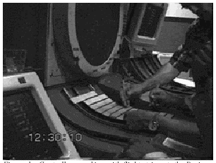
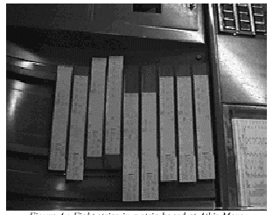
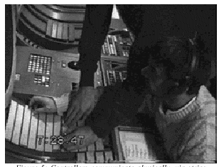
Social Computing
Example: ethnography in Air Traffic Control

Slide 6
Two Recent Trends (contd.)
Tangible Computing
“Interaction “with computers through physical objects” (Dourish, 1999).
physical interaction
augmented environments
computation as part of the physical world

Slide 7
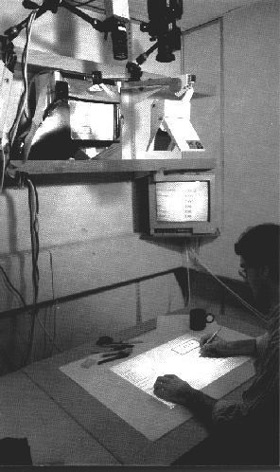
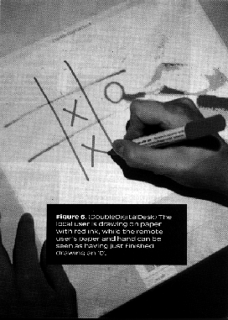
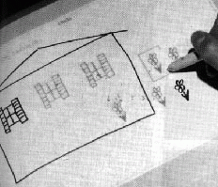
Tangible Computing
Example: Wellner’s digital desk
-interaction with paper and electronic documents.

Slide 8
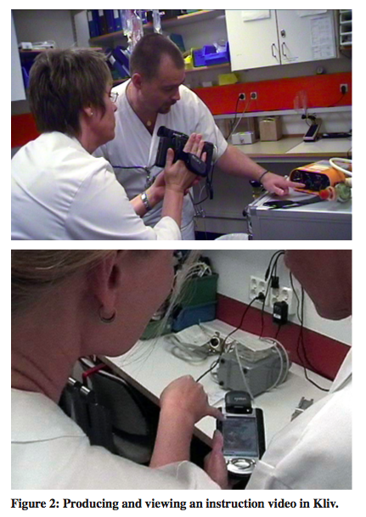
Inspirational or I-Patterns
Virtual information is tied to positions in the material world.

Slide 9
Inspirational or I-Patterns (contd.)
Virtual bookmarks are tokens of positions in the material world

Slide 10
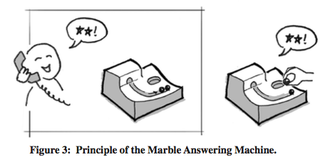
Inspirational or I-Patterns (contd.)
Material objects are tokens of virtual information.

Slide 11
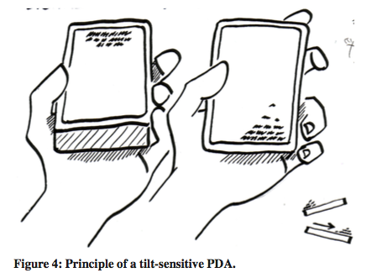
Inspirational or I-Patterns (contd.)
Virtual information has material properties

Slide 12
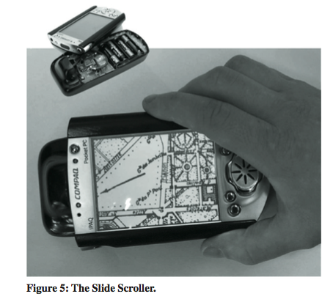
Inspirational or I-Patterns (contd.)
Virtual information forms objects in the material world

Slide 13
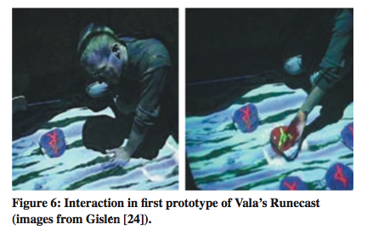
Inspirational or I-Patterns (contd.)
Material object qualities influence interaction qualities

Slide 14
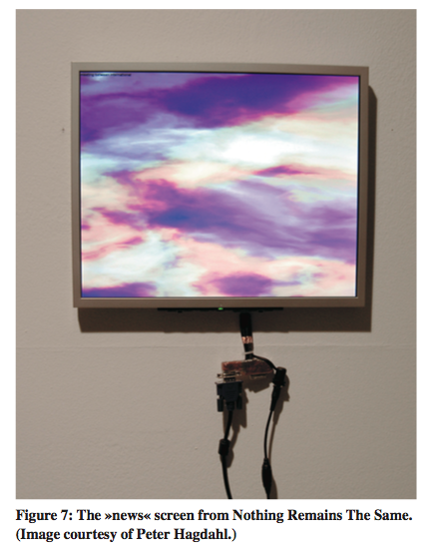
Inspirational or I-Patterns (contd.)
Heterogeneous virtual information fuses into a few sensory parameters

Slide 15
Inspirational or I-Patterns (contd.)
Interactive and broadcast media combine to form a positive spiral of participation.
Virtual information and functions are limited to certain times.

Slide 16

How Bodies Matter?
“The body is the ultimate instrument of all our external knowledge, whether intellectual or practical… experience [is] always in terms of the world to which we are attending from our body.” —Michael Polanyi.
“we know more than we can tell”.
To elucidate this assertion, consider riding a bicycle.

Slide 17
Five Themes For Interaction Design
Thinking Through Doing
Performance
Visibility
Risk
Thick Practice

Slide 18
Thinking Through Doing
Thinking through doing, describes how thought (mind) and action (body) are deeply integrated and how they co-produce learning and reasoning.
Unlike theories of information processing and human cognition that focus primarily on thought as something that only happens in the head, theories and research of embodied cognition regard bodily activity as being essential to understanding human cognition.

Slide 19
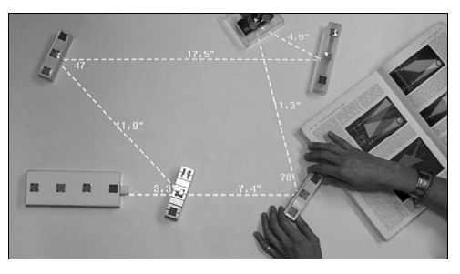
Thinking Through Doing
Learning through doing
Being able to move around in the world and interact with pieces of the world enables learning in ways that reading books and listening to words do not.
Physical reasoning can also play an important role in professional and higher education. An example is MIT’s Illuminating Light interface, which enables users to combine rapid creation of light reflection simulations by moving tangible objects on a tabletop surface

Slide 20
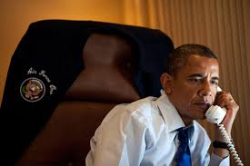
Thinking Through Doing
Role of Gesture
Gesture plays a role in pre-linguistic communication for babies as well as aids cognition and fully linguistic communication for adults.
Systems that constrain gestural are likely to hinder the user’s thinking and communication.

Slide 21
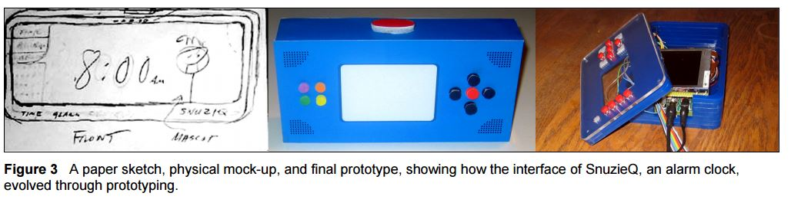
Thinking Through Doing
Thinking through prototyping
Successful product designs result from a series of “conversations with materials.”
Here, the “conversations” are interactions between the designer and the design medium — sketching on paper, shaping clay, building with foam core etc.

Slide 22

Performance
Describes the rich actions our bodies are capable of, and how physical action can be both faster and more nuanced than symbolic cognition.
For example, experienced puppeteers can see through the eyes of their puppet and feel the ground through the puppet’s feet.

Slide 23
Performance
Action-Centered Skills
Hands
- Entire professions, such as surgeons, sculptors, jewelers, musicians and puppeteers rely almost exclusively on their hands as the principle organ of expression, yet such capabilities are seldom exploited in computer systems.
Motor Memory
- We are able to sense, store and recall our own muscular effort, body position and movement to build skill (motor memory).
- Involves in knowing how to ride a bicycle, how to swim, how to improvise on the piano.

Slide 24
Visibility
Visibility describes the role of artifacts in collaboration and cooperation.
“The fact that the paper [air traffic control flight] strips are physically laid out in space and annotated directly (rather than indirectly through, for example, a keyboard) means that the activities of co-workers interacting with the strips can be perceived, providing mutual awareness for collaboration.” —Abigail Sellen and Richard Harper

Slide 25
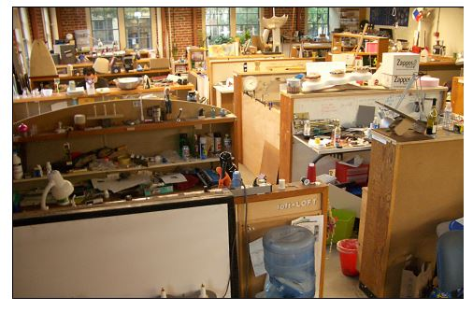
Visibility
Situated Learning
An important method of learning is learning by participating in a community of practice.
Example: Stanford Product Design Loft Studios

Slide 26
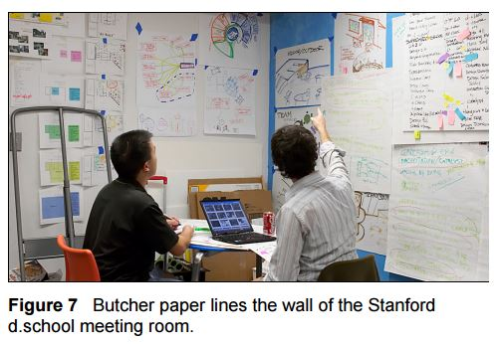
Visibility
Visibility facilitates coordination
In addition to supporting situated learning and peripheral participation, the production and manipulation of visible artifacts in the workplace facilitate coordination.
Example: Air traffic Control management of flight strips.

Slide 27
Risk
“But where there is no risk and every commitment can be revoked without consequences, choice becomes arbitrary and meaningless.”—Hubert Dreyfus
Risk explores how the uncertainty and risk of physical co-presence shapes interpersonal and human-computer interactions.

Slide 28
Risk
Trust and Commitment
Situations that involve more risk can also stimulate more committed involvement.
“Because the computer doesn’t permanently record what you write, you feel less committed when you type on it”
Personal Responsibility
Attention
- Situations of higher risk cause people to feel more emotionally negative and, therefore, more focused.
- However, there are other times when divergent thinking, e.g., brainstorming, is more appropriate.

Slide 29
Thick Practice
Thickness of practice, suggests that because the pursuit of digital verisimilitude is more difficult than it might seem, embodied interaction is a more prudent path.
Interfaces that are the real world can obviate many of the difficulties of attempting to model all of the salient characteristics of a work process as practiced.

Slide 30
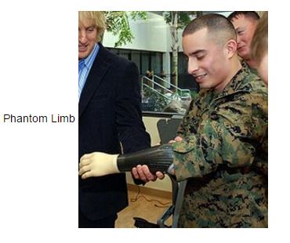
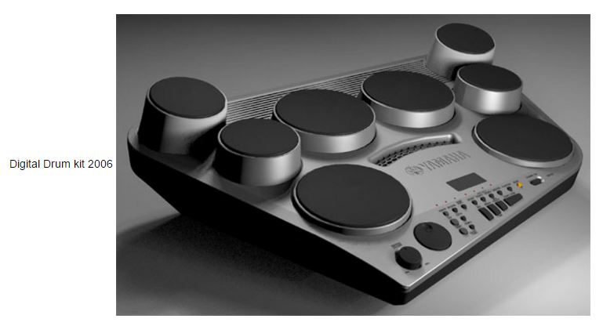
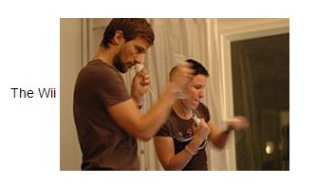
Embodied Interaction In Use
Science/Robotics
Music
Gaming

Slide 31
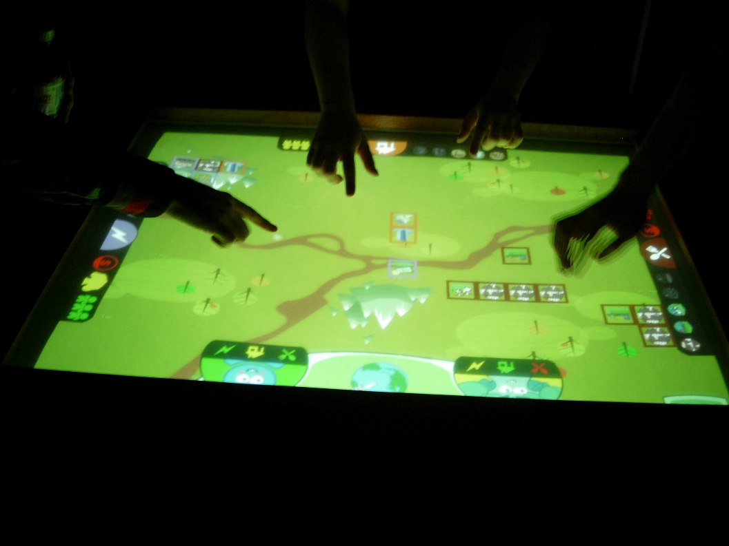
Futura: Multi-touch Digital Tabletop Game
Incorporates experiential learning (learning by doing) and collaborative learning through the use of a microworld game simulation for balancing between the population of the game world and their effect on the environment.

Slide 32
Conclusion
Embodiment is a foundation for new HCI models
tangible and social computing
a common focus on participation and meaning
Turning to phenomenology
a conceptual understanding of embodiment
6 design principles
steps towards an account of embodied interaction

Slide 33
Q/A

Slide 34
Reference
How Bodies Matter: Five Themes for Interaction Design (2006) by Scott R. Klemmer , Björn Hartmann
Inspirational Patterns for Embodied Interaction by Jonas Löwgren.
Embodied Interaction: Exploring the Foundations of a New Approach to HCI by Paul Dourish
http://wiki.csisdmz.ul.ie/wiki/Embodied_Interaction
MIT Media Lab Report

